Slide 1
Monitorowanie trenowania modeli
Weronika Hryniewska

Slide 2
Wywołania zwrotne
my_callbacks = [ tf.keras.callbacks.EarlyStopping(patience=2), tf.keras.callbacks.ModelCheckpoint(filepath='model.{epoch:02d}-{val_loss:.2f}.h5'), tf.keras.callbacks.TensorBoard(log_dir='./logs'), ] model.fit(dataset, epochs=10, callbacks=my_callbacks)

Slide 3
Co umożliwia TensorBoard?
https://www.tensorflow.org/tensorboard/get_started

Slide 4
Wiele wejść, wiele wyjść i zespoły klasyfikatorów
Weronika Hryniewska

Slide 5
Dwa sposoby definiowania modelu
model = Sequential()
model.add(Dense(8, input_shape=(10,), activation="relu"))
model.add(Dense(4, activation="relu"))
model.add(Dense(1, activation="linear")
inputs = Input(shape=(10,))
x = Dense(8, activation="relu")(inputs)
x = Dense(4, activation="relu")(x)
x = Dense(1, activation="linear")(x)
model = Model(inputs, x)

Slide 6
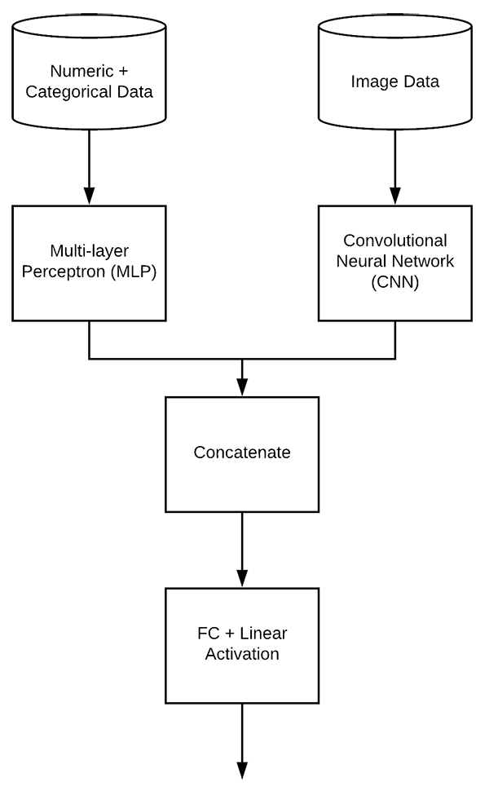
Dwa wejścia
www.pyimagesearch.com/2019/02/04/keras-multiple-inputs-and-mixed-data

Slide 7
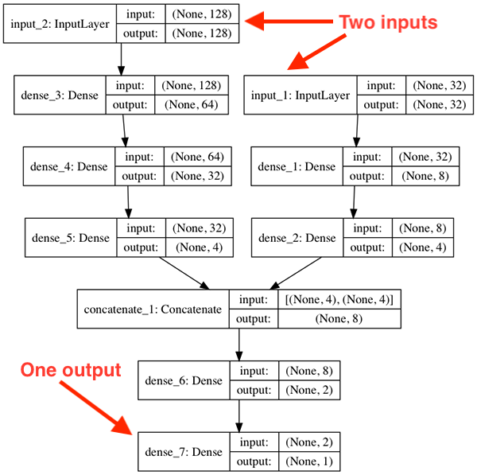
# define two sets of inputs
inputA = Input(shape=(32,))
inputB = Input(shape=(128,))
# the first branch operates on the first input
x = Dense(8, activation="relu")(inputA)
x = Dense(4, activation="relu")(x)
x = Model(inputs=inputA, outputs=x)
# the second branch opreates on the second input
y = Dense(64, activation="relu")(inputB)
y = Dense(32, activation="relu")(y)
y = Dense(4, activation="relu")(y)
y = Model(inputs=inputB, outputs=y)
# combine the output of the two branches
combined = concatenate([x.output, y.output])
# apply a FC layer and then a regression prediction on the combined outputs
z = Dense(2, activation="relu")(combined)
z = Dense(1, activation="linear")(z)
# our model will accept the inputs of the two branches and then output a single value
model = Model(inputs=[x.input, y.input], outputs=z)
www.pyimagesearch.com/2019/02/04/keras-multiple-inputs-and-mixed-data

Slide 8
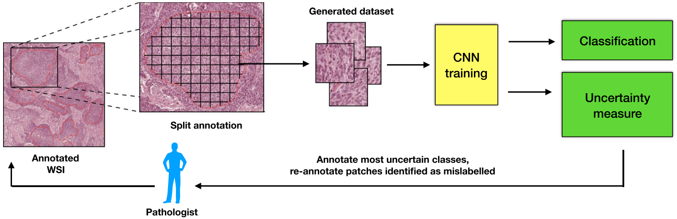
Dwa wyjścia
Rączkowski, Ł., Możejko, M., Zambonelli, J. et al. ARA: accurate, reliable and active histopathological image classification framework with Bayesian deep learning. Sci Rep 9, 14347 (2019). https://doi.org/10.1038/s41598-019-50587-1

Slide 9
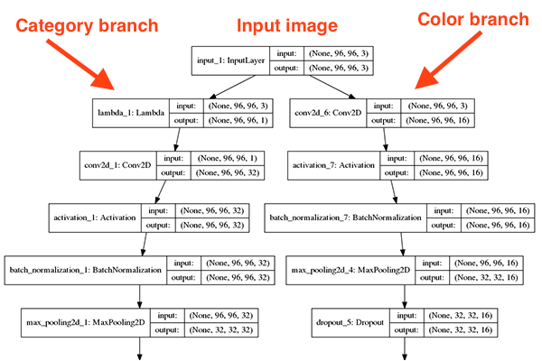
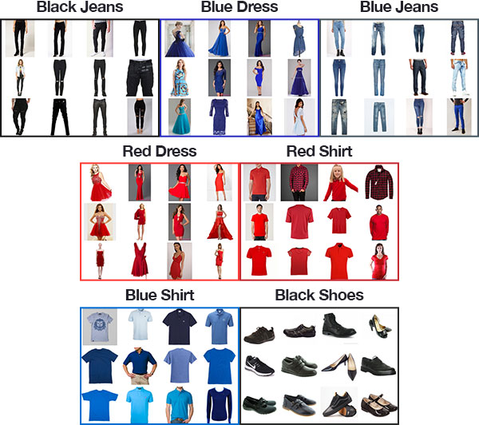
www.pyimagesearch.com/2018/06/04/keras-multiple-outputs-and-multiple-losses

Slide 10
class FashionNet:
@staticmethod
def build_category_branch(inputs, numCategories, finalAct="softmax", chanDim=-1):
…
x = Dense(numCategories)(x)
x = Activation(finalAct, name="category_output")(x)
return x
losses = {"category_output": "categorical_crossentropy", "color_output": "categorical_crossentropy"}
lossWeights = {"category_output": 1.0, "color_output": 1.0}
model.compile(optimizer=Adam(), loss=losses, loss_weights=lossWeights,
metrics=["accuracy"])
www.pyimagesearch.com/2018/06/04/keras-multiple-outputs-and-multiple-losses

Slide 11
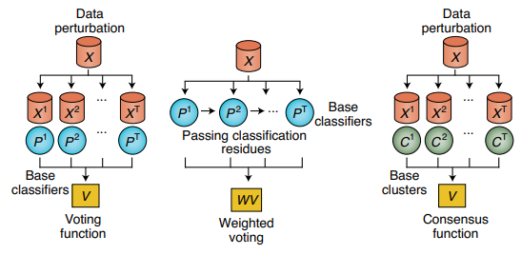
Zespoły modeli
bagging-, boosting-, stacking-based methods
Cao, Y., Geddes, T.A., Yang, J.Y.H. et al. Ensemble deep learning in bioinformatics. Nat Mach Intell 2, 500–508 (2020). https://doi.org/10.1038/s42256-020-0217-y

